Slide 1
Azure Training Day Migrating .NET applications to Azure

Slide 2

Presentation title
Let’s get Started!
Tell us what you think by completing our survey
Schedule a post-event session to address your specific requirements.
Speaker name
Title
Learn more : aka.ms/techdocs
Get certified : aka.ms/microsoftlearn
Sign up Developer newsletter: aka.ms/usdevconnect

Slide 3


About Me…
Peter De Tender – MCT, Azure MVP
CEO and Lead Technical Trainer of 007FFFLearning.com, +20 years IT experience, mainly datacenters and Microsoft Infrastructure background
Full-time in Azure since 2013 (Readiness & Architect)
Azure Advisor, Azure Certified Architect
Technical Writer, Book author, Courseware Creator
Living in Belgium, but traveling worldwide 90% of my time, helping larger Microsoft Partners, customers and Microsoft FTEs in learning about and using Azure, by providing workshops with passion
peter@pdtit.be
@pdtit @007FFFLearning
http://www.facebook.com/pdtit
http://www.linkedin.com/in/pdtit

Slide 4
Workshop delivery
For the technical trainers:
Each Module could be presented as a stand-alone module, although the full potential comes from delivering all modules
HOL are somehow depending on each other, starting from the IAC-lab, where students deploy the VM-based source environment, moving to WebApps, SQL PaaS, Docker, Azure Container Registry, running Azure Container Instance, and ultimately Azure Container Services with Kubernetes. (only labs that could be skipped are WebApps and AKS)
The HOL solution is based on a ASP.NET Core app « SimplCommerce » (Open Source), using SQL Database

Slide 5
Workshop delivery
For the technical trainers:
Whenever you detect any mistakes, issues, wrong wordings,… in presentations or LAB guides, please send an email to :
msdevseriessupport@007FFFLearning.com, subject « Azure Developer Series – Containers », so we can take care of this and fixing it immediately
Latest version of all content should be available on GitHub:
http://www.github.com/007FFFLearning/MSDevSeriesSupport

Slide 6
Application Migration
Migrating an ASP.NET application to Azure using different Container services
Peter De Tender
@pdtit @007FFFLearning
Aug 2019

Slide 7
Azure Assessments
Knowing what to migrate, without surprises!

Slide 8
What do customers want to migrate to the Cloud?
Virtual Machines
Databases
Data
Applications
Azure

Slide 9
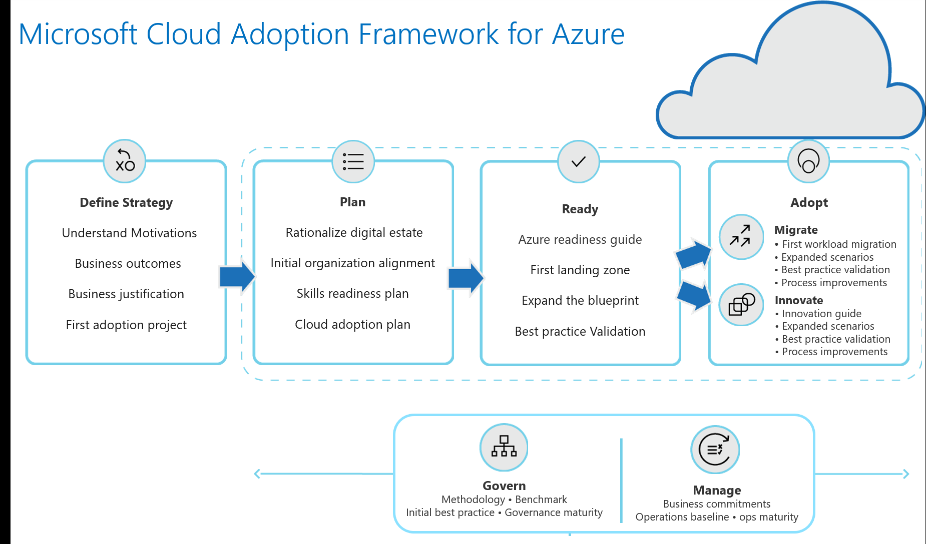
Microsoft Cloud Adoption Framework for Azure

Slide 10
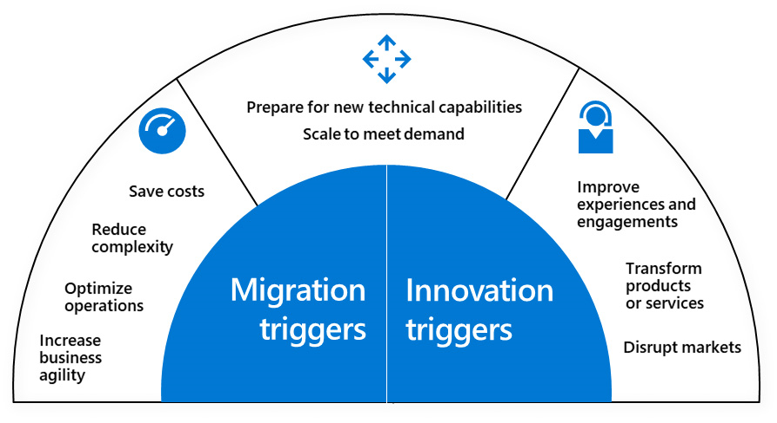
Common migration and innovation triggers
Notes:
The Microsoft Cloud Adoption Framework for Azure enables an actionable cloud journey that rapidly delivers on the desired business outcomes.
There are three main stages of the Cloud Adoption Framework: Plan, Ready, and Adopt.
Some common migration and innovation triggers include:
Preparation for new technical capabilities
Adjust scale to meet market or geographic demands
Cost savings
Reduction in vendor or technical complexity
Optimization of internal operations
Increased business agility
Improvements to customer experiences or engagements
Transformation of products or services
Disruption of the market from new products or services

Slide 11
Azure migration journey
Assess
Migrate
Optimize
Discover/Assess phase brings visibility into apps, workloads, and data in your environment
Migrate your selected workloads to Azure
Optimize your Azure-based workloads to realize the benefits of moving them to the cloud
Notes:
Technical (e.g., Networking) | Process (e.g., DevOps) | People (e.g., cloud 101 skills)

Slide 12
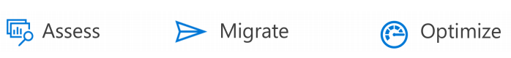
Migration Phases - Assess
Assessment
use a mixture of software tools and consultancy best practices to:
discover what applications can be migrated,
what their current configurations are,
the people within your customer that will be impacted by the migration,
identify the dependencies of the application.
The output of your assessment will include a comprehensive plan for what to do with the application and the expectations on availability and functionality.
Notes:
ASSESS
The assessment phase is where your team will use a mixture of software tools and consultancy best practices to discover what applications can be migrated, what their current configurations are, the people within your customer that will be impacted by the migration, as well as identify the dependencies of the application. The output of your assessment will include a comprehensive plan for what to do with the application and the expectations on availability and functionality.
MIGRATE
The migration phase is when the recommendations in your assessment plan are put into place. The following steps are usually taken.
• Setup Azure subscriptions using best practices for security, connectivity, policies and general governance prior to migration to ensure your customers are using Azure correctly from the start.
• Perform the migration using the prescribed method identified in the assessment plan: rehost, retire, replace, rearchitect or retain.
• Evaluate and test to ensure the migrated application meets the criteria outlined in your assessment.
OPTIMIZE
In the optimization phase, you will use Azure security and management resources to govern, secure, and monitor your cloud applications in Azure. This is also the time for you to look for opportunities to optimize spending. Common tasks at this stage are:
• Review Azure cost management to track spending and identify areas for cost savings.
• Evaluate migrated applications for opportunities to right size over provisioned virtual machines and services.
• Implement automation to resize or stop based on a utilization schedule.
• Identify applications that could benefit from optimization with platform as a service (PaaS) services or containers.

Slide 13
Migration Phases - Migrate
Migrate
The following steps are usually taken:
Setup Azure subscriptions using best practices for security, connectivity, policies and general governance prior to migration to ensure your customers are using Azure correctly from the start.
Perform the migration using the prescribed method identified in the assessment plan: rehost, retire, replace, rearchitect or retain.
Evaluate and test to ensure the migrated application meets the criteria outlined in your assessment.
Notes:
ASSESS
The assessment phase is where your team will use a mixture of software tools and consultancy best practices to discover what applications can be migrated, what their current configurations are, the people within your customer that will be impacted by the migration, as well as identify the dependencies of the application. The output of your assessment will include a comprehensive plan for what to do with the application and the expectations on availability and functionality.
MIGRATE
The migration phase is when the recommendations in your assessment plan are put into place. The following steps are usually taken.
• Setup Azure subscriptions using best practices for security, connectivity, policies and general governance prior to migration to ensure your customers are using Azure correctly from the start.
• Perform the migration using the prescribed method identified in the assessment plan: rehost, retire, replace, rearchitect or retain.
• Evaluate and test to ensure the migrated application meets the criteria outlined in your assessment.
OPTIMIZE
In the optimization phase, you will use Azure security and management resources to govern, secure, and monitor your cloud applications in Azure. This is also the time for you to look for opportunities to optimize spending. Common tasks at this stage are:
• Review Azure cost management to track spending and identify areas for cost savings.
• Evaluate migrated applications for opportunities to right size over provisioned virtual machines and services.
• Implement automation to resize or stop based on a utilization schedule.
• Identify applications that could benefit from optimization with platform as a service (PaaS) services or containers.

Slide 14
Migration Phases - Optimize
Optimize
use Azure security and management resources to govern, secure, and monitor your cloud applications in Azure.
Common tasks at this stage are:
Review Azure cost management to track spending and identify areas for cost savings.
Evaluate migrated applications for opportunities to right size over provisioned virtual machines and services.
Implement automation to resize or stop based on a utilization schedule.
Identify applications that could benefit from optimization with platform as a service (PaaS) services or containers.
Notes:
ASSESS
The assessment phase is where your team will use a mixture of software tools and consultancy best practices to discover what applications can be migrated, what their current configurations are, the people within your customer that will be impacted by the migration, as well as identify the dependencies of the application. The output of your assessment will include a comprehensive plan for what to do with the application and the expectations on availability and functionality.
MIGRATE
The migration phase is when the recommendations in your assessment plan are put into place. The following steps are usually taken.
• Setup Azure subscriptions using best practices for security, connectivity, policies and general governance prior to migration to ensure your customers are using Azure correctly from the start.
• Perform the migration using the prescribed method identified in the assessment plan: rehost, retire, replace, rearchitect or retain.
• Evaluate and test to ensure the migrated application meets the criteria outlined in your assessment.
OPTIMIZE
In the optimization phase, you will use Azure security and management resources to govern, secure, and monitor your cloud applications in Azure. This is also the time for you to look for opportunities to optimize spending. Common tasks at this stage are:
• Review Azure cost management to track spending and identify areas for cost savings.
• Evaluate migrated applications for opportunities to right size over provisioned virtual machines and services.
• Implement automation to resize or stop based on a utilization schedule.
• Identify applications that could benefit from optimization with platform as a service (PaaS) services or containers.

Slide 15
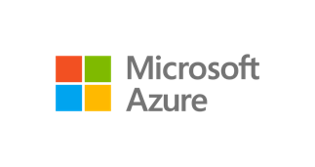
Azure migration vision
Do it yourself
Azure TCO calculator | Azure migration center | Azure Essentials
Azure Migrate: Unified, Extensible experience
Assess
Migrate
Optimize
Server Assessment Service
Server Migration Service
Database Migration Service
Storage Migration Service
Data Box
Security and Management
On-premises
Azure
ISV integration | Migration progress tracking
Assisted
FastTrack for Azure | Managed Service Providers | Systems integrators
Notes:
Talking points
Land vision
Migration is a journey. <Click> There is point A (i.e., on-premises source) and point B (i.e., Azure destination). Workloads – i.e., applications, databases, data, servers – needs to move from A to B.
We are making key investments to help customers be successful with the move:
<Click> Repeatable process & tooling to added workload specific as well as wholesale datacenter migration. Provide specific examples – e.g., we have tools to assess and move servers, tools to migrate data at
large scale, tools to migrate databases at scale etc. And we’re agnostic to 1st party vs. 3rd party tools. Our goal is to get customers to Azure.
<Click> DIY resources to help customers build their business case, have the right scenario guidance, and build the right cloud skills: TCO analysis, Azure migration center, Azure Essentials training
<Click> Assist models: Customer success programs like FastTrack/JumpStart along with a rich migration partner ecosystem

Slide 16
Azure is the only consistent hybrid cloud
Azure Active Directory
Azure IaaS/PaaS
Services
Azure Data Services
Azure Security and Management
Common identity
Unified cloud platform
Data
platform
Security and management
Active Directory
Azure Stack
SQL Server, support for MySQL,
PostgreSQL, NoSQL
On-premises infrastructure
Notes:
Hybrid
The strength of the hybrid strategy is about the continuum of capabilities across the offerings, it’s not just about the platform.
Hybrid is more than just being able to move an application into the cloud.
There are critical elements from identity, data, and security and management that have to be addressed.
You don’t have to be stuck in an all-or nothing choice – hybrid gives you the flexibility to move to the cloud when and how you want to.

Slide 17
Get started at no cost: Built-in tools at each stage
Pre-migration
During migration
Post-migration
Azure Migrate
Azure Site Recovery
Azure cost management
Notes:
Inline offers?

Slide 18

















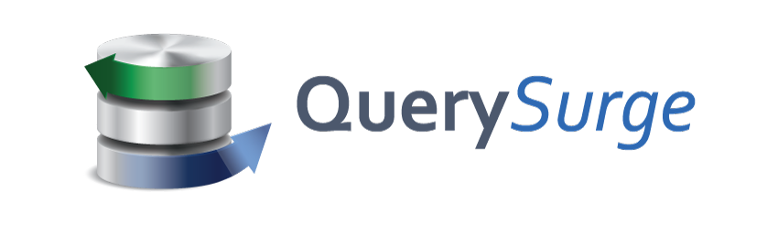
Choice of tools for every stage and every requirement
Assess
Migrate
Optimize
Secure & Manage
Azure Migrate
Azure Site Recovery (ASR)
Azure Cost Management
Azure Security & Management
(e.g., Blueprint, Security Center, Backup, Monitor)
Data Migration Assistant (DMA)
Azure Database Migration Service
SQL Server Migration Assistant (SSMA)
Azure Data Box
Partners
Notes:
Microsoft migration tools/services in action, aligned with the broader phases of the workload migration journey….Discover/Catalog/Assess → move and then keep stuff optimized post the move, be it secure/managed and cost-optimized.
We’d love your feedback on these terms…assessment
While we have numerous MSFT tools, we are working to make this better on two fronts:
stitch together experiences so customers don’t see the seams as they work from one phase to another.
consistent naming taxonomy consistency. Azure Migrate – its everything. ASR -.
And then we have a bunch of great ISV tools that attach to each phase of the journey – we’re in many cases actively working to integrate our first party tools with these.

Slide 19
Azure Discovery and Assessment Tools

Slide 20
Discovery and Assessment using MAP Toolkit

Slide 21
Microsoft Assessment and Planning (MAP) Toolkit
Multi-product (Microsoft Servers, Exchange, SharePoint, Oracle, Office 365, Windows Clients, Vmware hosts,…) assessment and planning
Agentless data collection technologies to gather inventory
Performance collection as option
The main areas of planning:
Migration Planning
Consolidation/Virtualization
Private/Public Cloud Planning
Software Usage Tracking

Slide 22
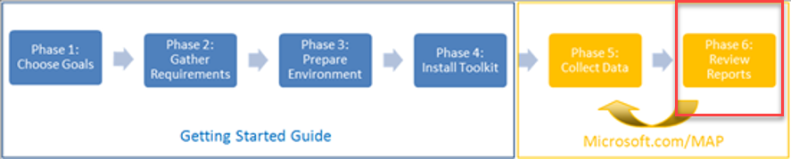
MAP Toolkit
Inventory | Assessment | Reporting
Data collection based on WMI, Active Directory, local admin permissions, network IP ranges
inventories hardware, Operating System and installed software
Simplifies the planning process for migration to Azure
Notes:
http://social.technet.microsoft.com/wiki/contents/articles/17802.what-is-the-map-toolkit.aspx

Slide 23
Demo
Microsoft Assessment & Planning Toolkit

Slide 24
Discovery and Assessment using Azure Migrate

Slide 25



Azure Migrate – Assessment Tools
“… Azure Migrate is a collection of different assessment tools, allowing any organization to migrate any of their existing workloads to Azure…”
Azure Migrate – Server Assessment
Azure Migrate – Database Assessment
Azure Migrate – App Services Assessment
Performs assessment of source VMware environments
V2 also supports Hyper-V as source environment (not SCVMM yet)
Assessment and Migration from the same dashboard
Analyzes source database environments running SQL Server, to assess a migration to Azure SQL PaaS, Azure SQL Managed Instance or Azure SQL VMs
Migration can be executed using DMA (Data Migration Assistant)
Performs assessment of life-running web application servers
Detects the framework, source language, dependencies and other critical parameters, to make it supported on Azure Web Apps
Migration can also be executed from the same toolkit

Slide 26
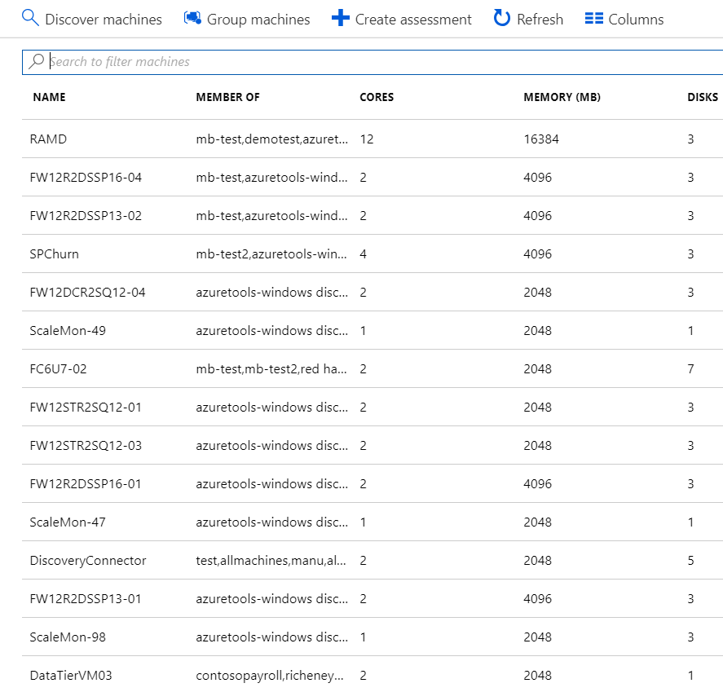
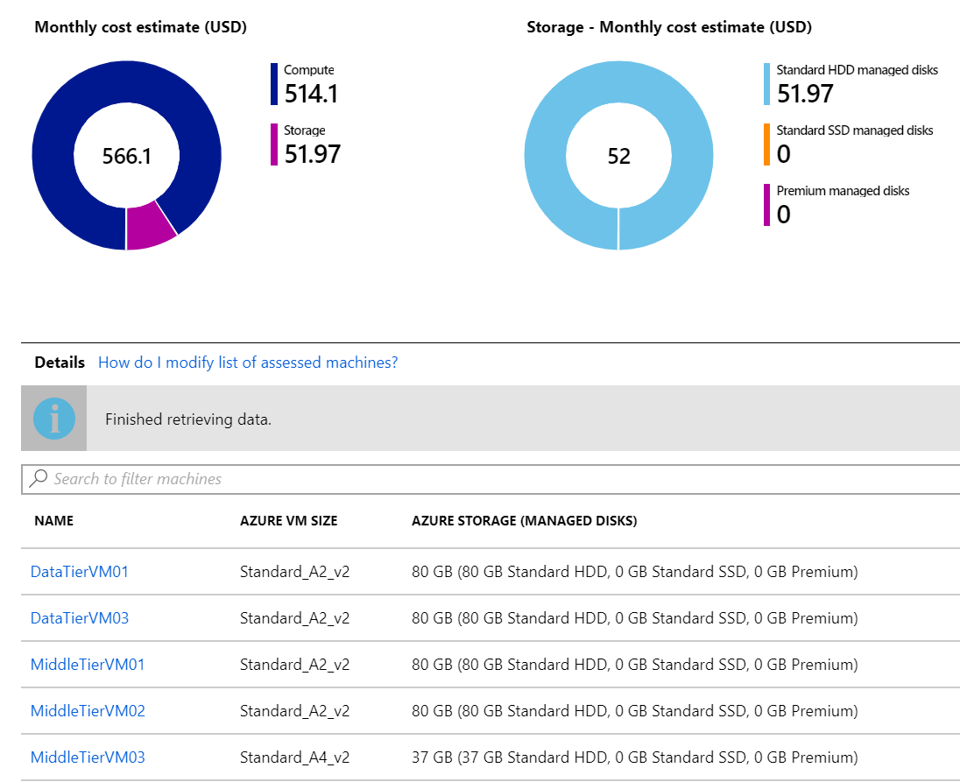
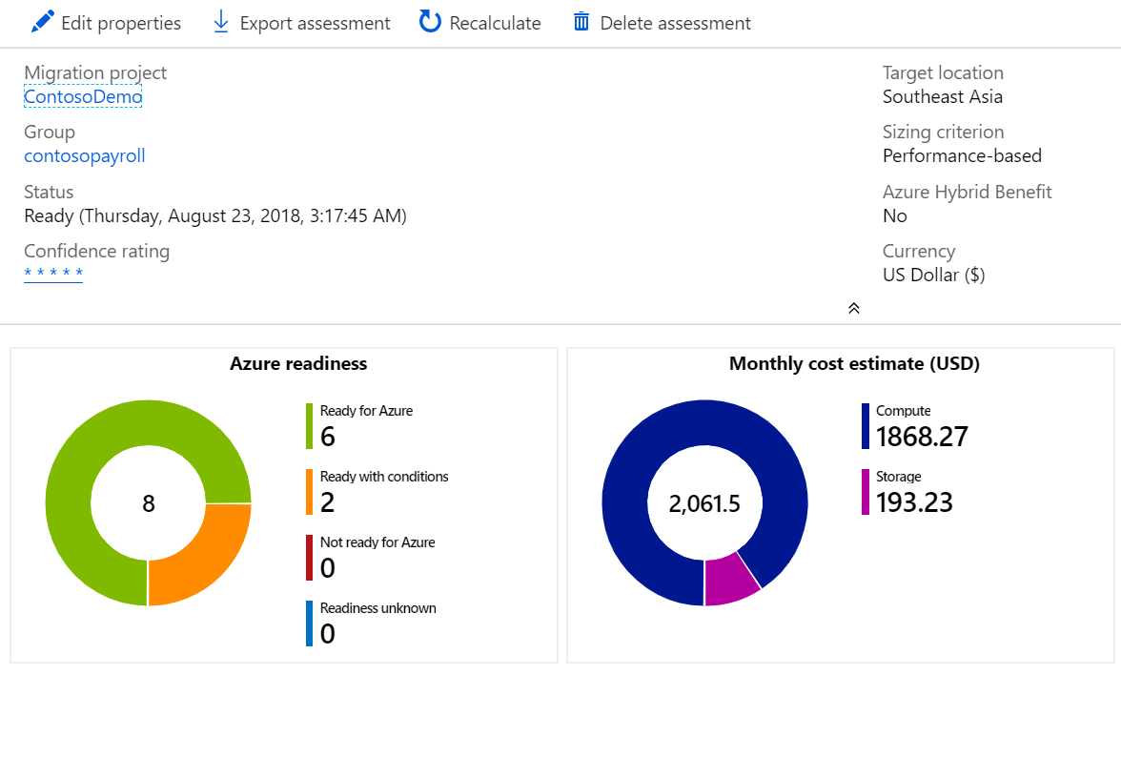
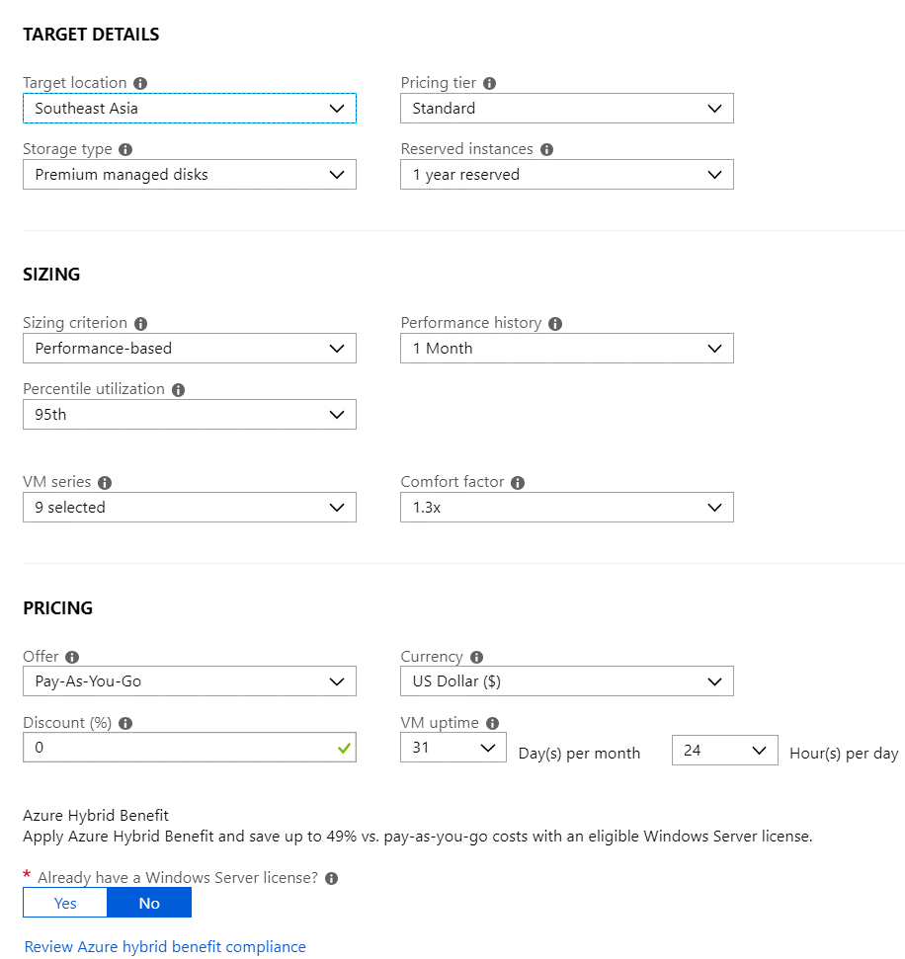
Azure Migrate for Discovery and Assessment
Agentless discovery
TCO calculation
Right-sized and suitability
Azure target platform

Slide 27



Azure Migrate – Process flow for VMware hosts
Raw metadata
Processed metadata
Appliance
Azure Migrate Service
Assessment
2. Start discovery
3. Create assessment
Raw metadata
vCenter Server
1. Download and configure appliance
Customer
vSphere server and VMs
Notes:
Timing precision?
Hit ISV assessment tools upfront in the deck. Using both in combination.

Slide 28
Azure Migrate – Discovery
Light Discovery - Appliance-based
No prerequisites on the source VM machine
Agentless
Uses the VMware host credentials for VM access
Supports VMWare
VM Operating System can be Microsoft Windows Server and Linux OS
Deep Discovery – Agent-based
Visualize dependencies of machines
Understand all server and application connections
Discover unknown relationships to ensure high-confidence migration

Slide 29
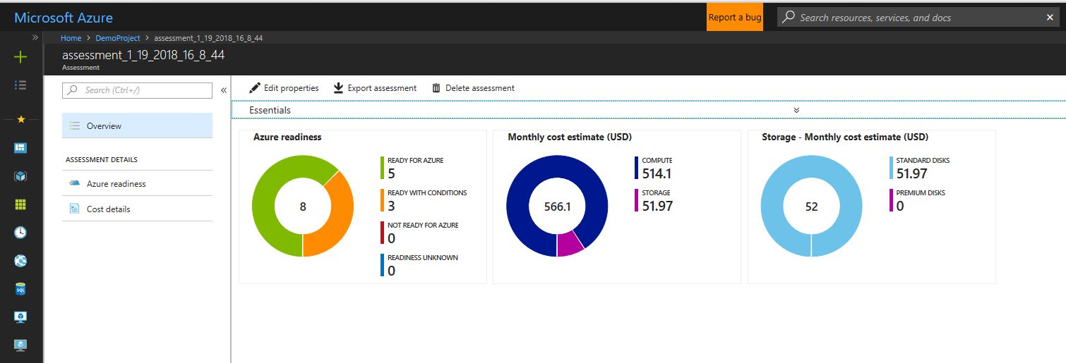
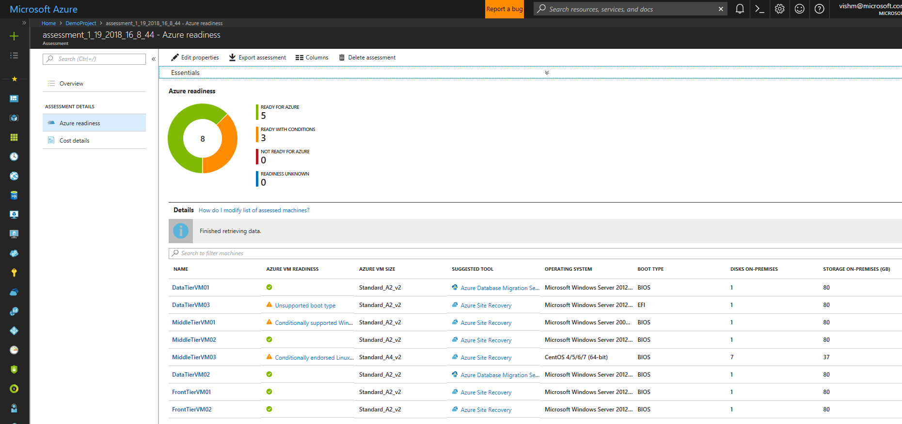
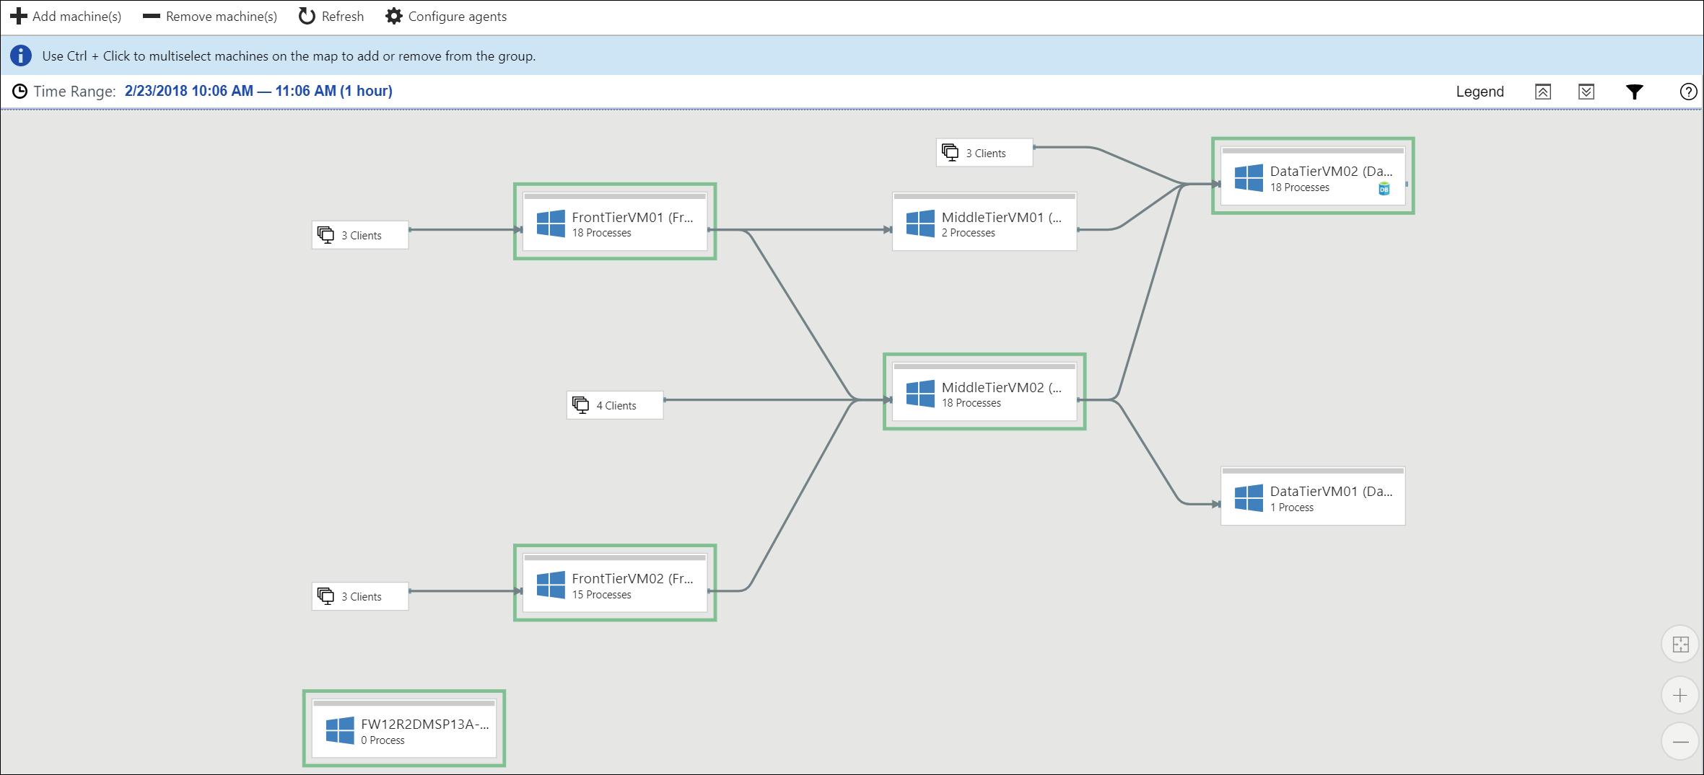
Azure Migrate Features
Discover and assess on-premises servers
Dependency visualization
Intelligent rightsizing for Azure VMs
Estimated monthly run costs in Azure
Compatibility reporting with guidelines for remediation
Service Map
Workload Migration Tool Guidance
Lift & Shift Server Migrations (Azure Site Recovery)
Database Migrations (Database Migration Service)
Notes:
Service Map automatically discovers application components on Windows and Linux systems and maps the communication between services. With Service Map, you can view your servers in the way that you think of them: as interconnected systems that deliver critical services. Service Map shows connections between servers, processes, inbound and outbound connection latency, and ports across any TCP-connected architecture, with no configuration required other than the installation of an agent.
Azure Migrate and Azure Migrate v2 (currently in preview) use Service Map to enhance the reporting capabilities and dependencies across the environment.
To use dependency visualization, you need to download and install agents on each on-premises machine that you want to analyze.
Microsoft Monitoring agent (MMA) needs to be installed on each machine.
The dependency agent needs to be installed on each machine.
In addition, if you have machines with no internet connectivity, you need to download and install Log Analytics gateway on them.

Slide 30
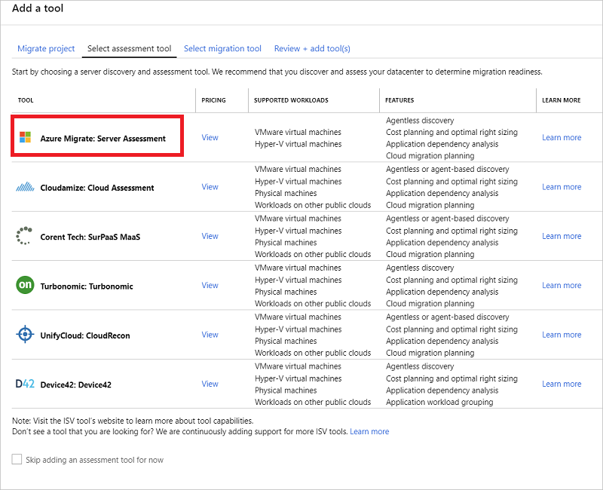
Azure Migrate – Assessment
Migration suitability
Deep assessment of VMs to determine Azure readiness
Guidance on remediation for suitability issues
Suggestion on tools for migration
Intelligent rightsizing
Performance-based right sizing for Azure
Cost estimation
Region, offer and currency specific
Supports Azure Hybrid Benefit for Windows Server

Slide 31
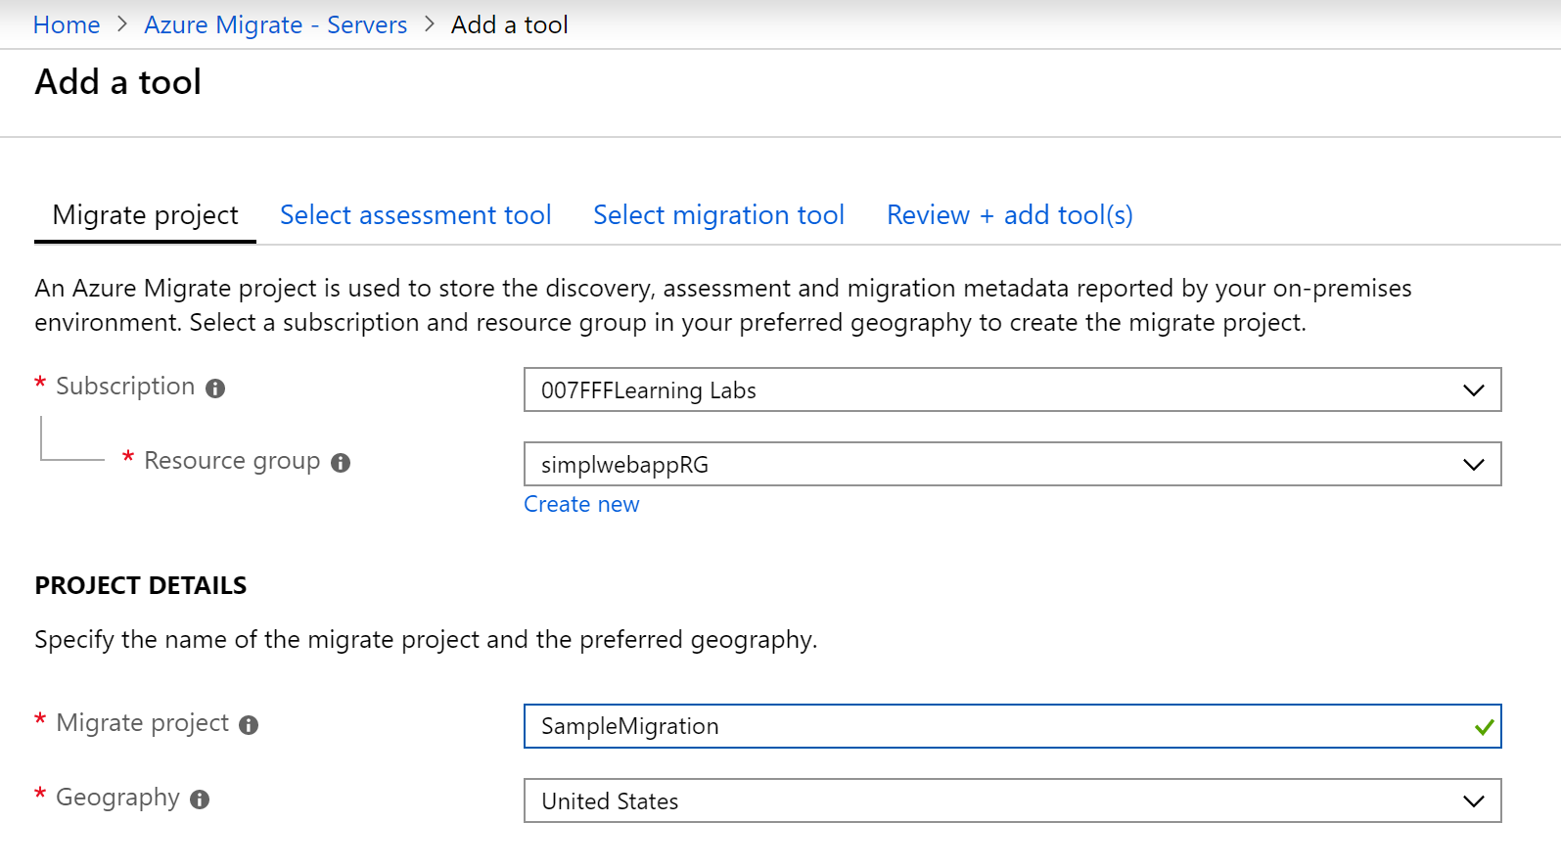
Creating a Project
Create an Azure Migrate project from the Azure portal to hold the metadata of your on-premises VMs
Discover up to 1500 VMs in a single project
Create multiple projects for larger environments
Notes:
✔️ Currently, you can only create an Azure Migrate project in West Central US or East US region. However, this does not impact your ability to plan your migration for a different target Azure location. The location of the migration project is used only to store the metadata discovered from the on-premises environment.
For more information, you can see:
Create a project - https://docs.microsoft.com/en-us/azure/migrate/tutorial-assessment-vmware#create-a-project
Current limitations - https://docs.microsoft.com/en-us/azure/migrate/migrate-overview#current-limitations

Slide 32
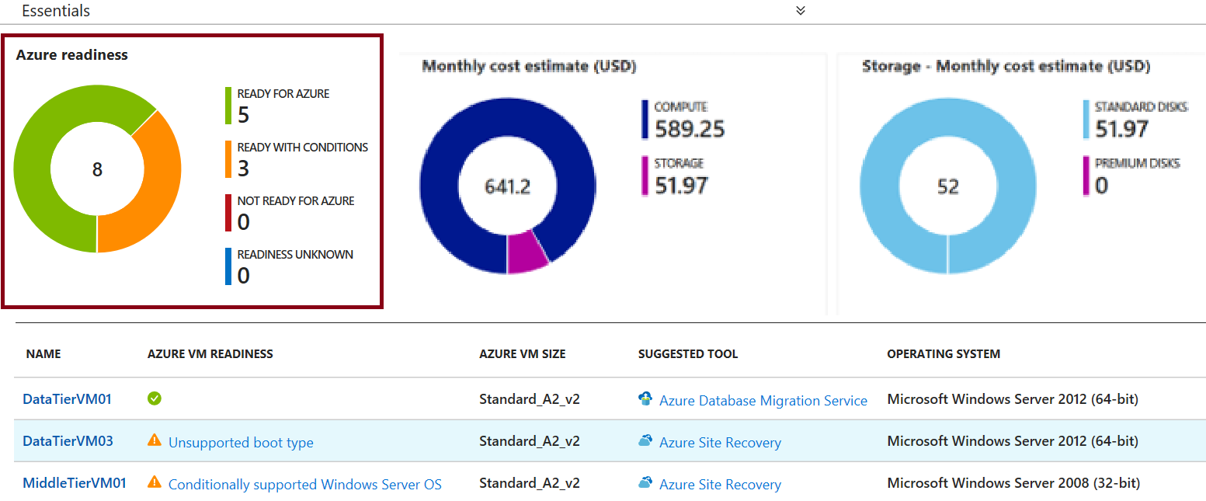
Assessing Readiness
Readiness view shows status for each VM discovered
Ready for Azure (Green)
Ready with conditions (Orange)
Not ready for Azure (Red)
Readiness unknown (Blue)
Notes:
✔️ Use the reference link for help troubleshooting readiness issues. For example, what to do if the disk count or disk size exceeds the limits.
For more information, you can see:
Azure suitability analysis - https://docs.microsoft.com/en-us/azure/migrate/concepts-assessment-calculation#azure-suitability-analysis

Slide 33
Assessing VM Sizing
Azure Migrate uses performance-based sizing to map on-premises VMs to Azure VMs + Accounts for on-premises over-allocation of VMs or low utilization
Storage: tries to map every attached disk to a disk in Azure
Network: looks for Azure VMs that can support the number of network adapters attached to a machine
Compute: assesses CPU and memory to find a suitably sized Azure VM
Notes:
✔️ The alternative to performance based sizing is as on-premises sizing. Azure Migrate allocates a VM SKU in Azure based on the size allocated on-premises. Similarly, for disk sizing, it looks at the Storage type and recommends the disk type accordingly. The default storage type is Premium disks.
For more information, you can see:
Sizing - https://docs.microsoft.com/en-us/azure/migrate/concepts-assessment-calculation#sizing

Slide 34
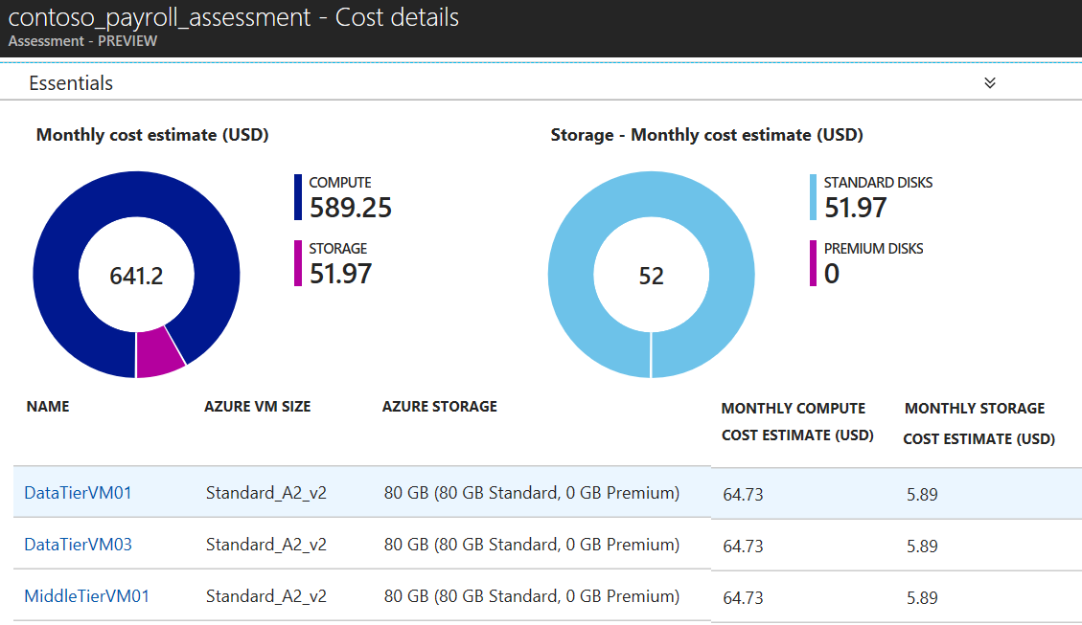
Estimating Cost
Cost assessment view with total monthly compute and storage costs
Compute
- Based on Billing API
- Aggregation across all machines
Storage
- Aggregates costs of all attached disks
Notes:
✔️ The cost estimation provided by Azure Migrate is for running the on-premises VMs as Azure Infrastructure as a service (IaaS) VMs. Azure Migrate does not consider any Platform as a service (PaaS) or Software as a service (SaaS) costs.
For more information, you can see:
Monthly Cost Estimate - https://docs.microsoft.com/en-us/azure/migrate/tutorial-assessment-vmware#monthly-cost-estimate

Slide 35
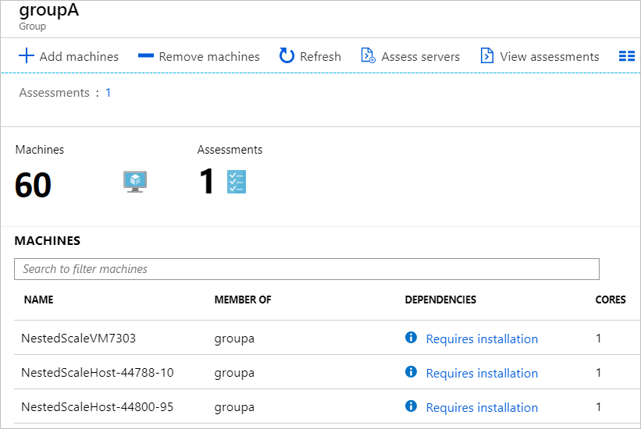
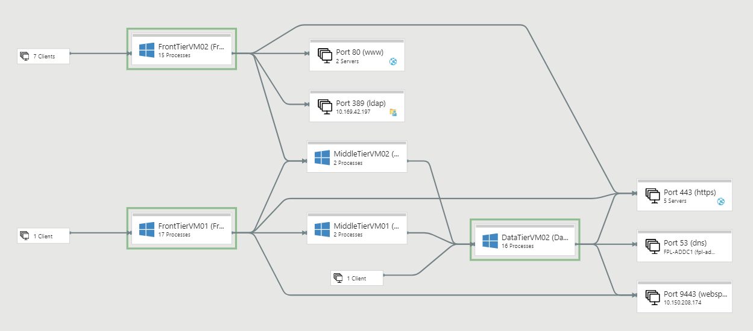
Service Map
Automatically discovers application components on Windows and Linux systems and maps the communication between services.
Shows connections between servers, processes, inbound and outbound connection latency, and ports across any TCP-connected architecture
Notes:
Service Map automatically discovers application components on Windows and Linux systems and maps the communication between services. With Service Map, you can view your servers in the way that you think of them: as interconnected systems that deliver critical services. Service Map shows connections between servers, processes, inbound and outbound connection latency, and ports across any TCP-connected architecture, with no configuration required other than the installation of an agent.
Azure Migrate and Azure Migrate v2 (currently in preview) use Service Map to enhance the reporting capabilities and dependencies across the environment.
To use dependency visualization, you need to download and install agents on each on-premises machine that you want to analyze.
Microsoft Monitoring agent (MMA) needs to be installed on each machine.
The dependency agent needs to be installed on each machine.
In addition, if you have machines with no internet connectivity, you need to download and install Log Analytics gateway on them.

Slide 36
Demo
Azure Migrate Assessment of Virtual Machine workloads

Slide 37
Assessment of SQL Server Databases

Slide 38
Azure Data Migration Assistant (SQL)
The Data Migration Assistant (DMA) helps you upgrade to a modern data platform by:
detecting compatibility issues that can impact database functionality in your new version of SQL Server or Azure SQL Database
DMA recommends performance and reliability improvements for your target environment
and allows you to move your schema, data, and uncontained objects from your source server to your target server
Assessment and migration can be run at once, or separate, as well as repeatable (Delta)

Slide 39
Azure Data Migration Assistant (SQL)
Supported Sources:
SQL Server 2005
SQL Server 2008
SQL Server 2008 R2
SQL Server 2012
SQL Server 2014
SQL Server 2016
SQL Server 2017 on Windows
Azure Targets:
SQL Server 2012
SQL Server 2014
SQL Server 2016
SQL Server 2017 on Windows and Linux
Azure SQL Database
Azure SQL Database Managed Instance

Slide 40
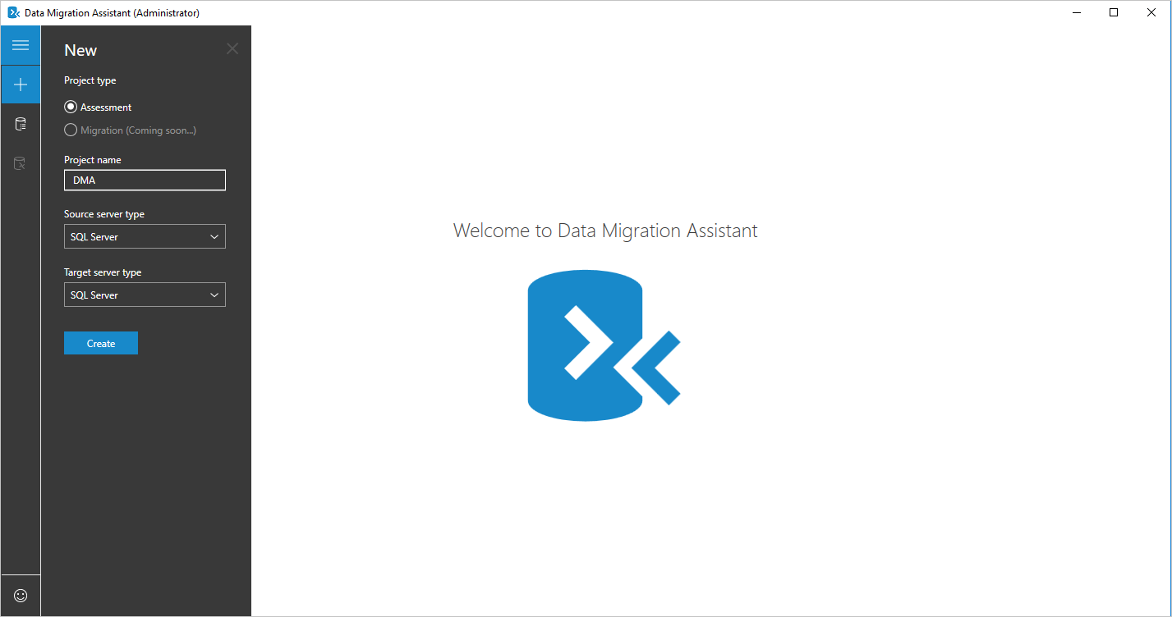
Azure Data Migration Assistant (SQL)
Download Data Migration Assistant (DMA) Tool
Create New Assessment

Slide 41
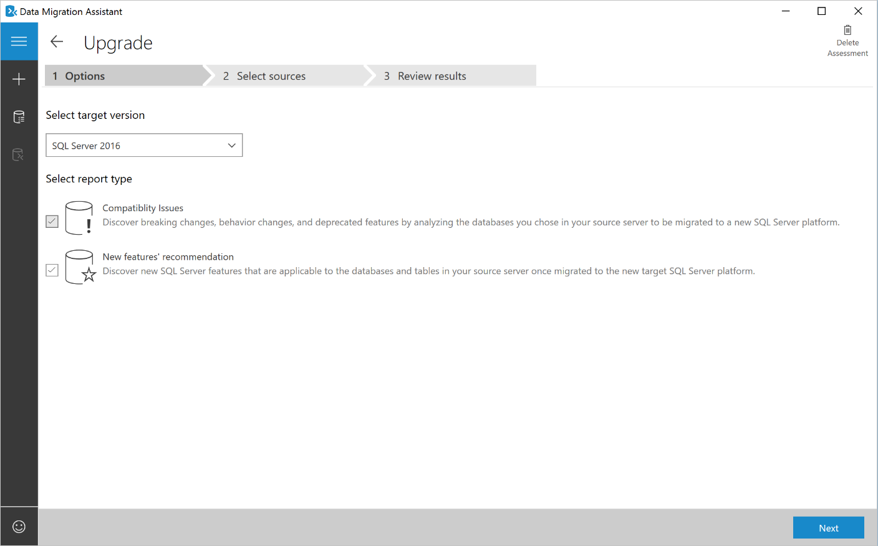
Azure Data Migration Assistant (SQL)
Download Data Migration Assistant (DMA) Tool
Create New Assessment
Choose Assessment Options

Slide 42
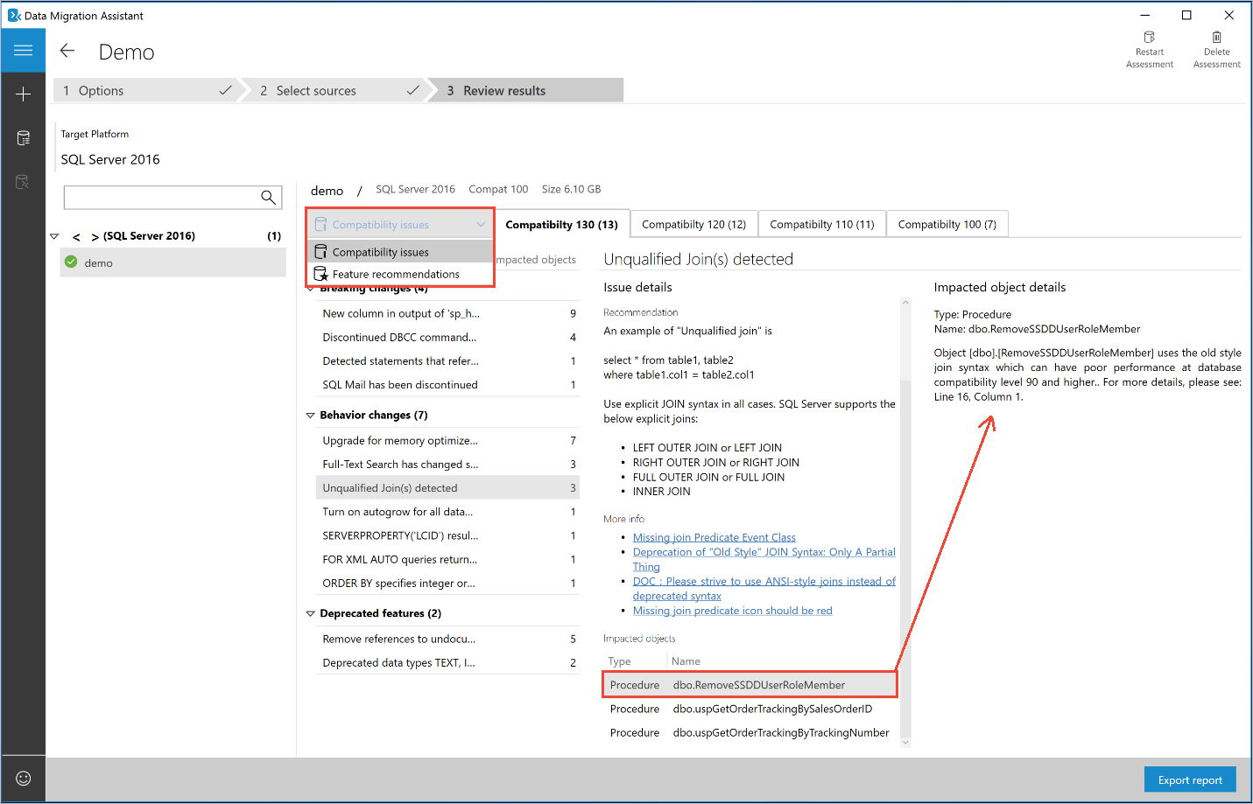
Azure Data Migration Assistant (SQL)
Download Data Migration Assistant (DMA) Tool
Create New Assessment
Choose Assessment Options
Review Results (Compatibility Issues)

Slide 43
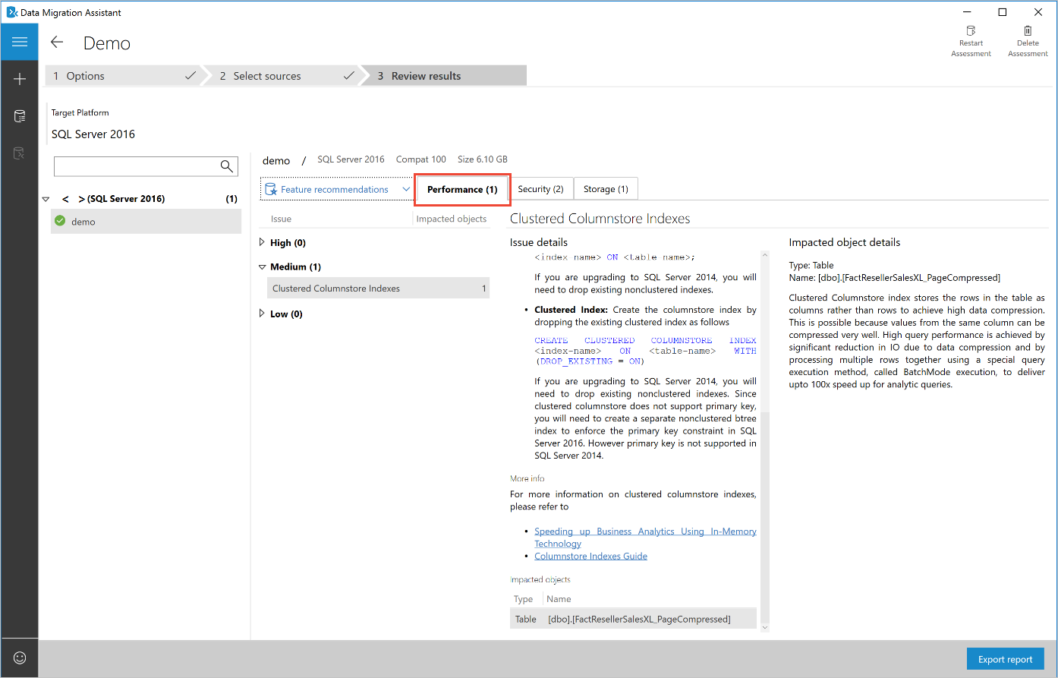
Azure Data Migration Assistant (SQL)
Download Data Migration Assistant (DMA) Tool
Create New Assessment
Choose Assessment Options
Review Results (Performance, Storage & Security)

Slide 44
Demo
Azure Database Migration Assistant

Slide 45
Assessment of (Web) Application Servers

Slide 46
Azure App Service Migration Assistant (Web)
The App Service Migration Assistant (SMA) helps you migrade to a modern web app platform by:
Performing an assessment to verify whether your app is a good candidate for migration by running a scan of its public URL
Running the assessment out-of-the-box, by downloading the App Migration Assistant
Use the tool to run readiness checks and general assessment of application config settings, before running the actual migration
If assessment is successful, you have the option to perform the migration of the app as well from the same tool

Slide 47
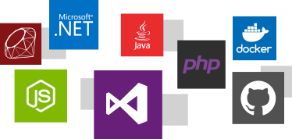
Azure App Service Migration Assistant (Web)
Supports more than just Microsoft Development Languages:
DotNet & DotNetCore
Ruby
Java
JavaScript
PHP
Docker
Git

Slide 48
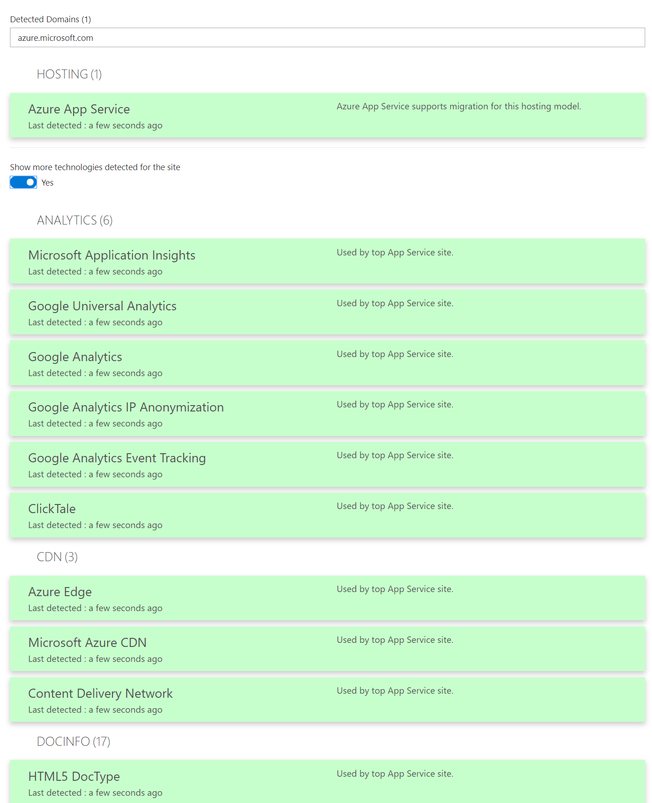
Azure App Service Migration Assistant (Web)
The Migration Assistant performs the following checks:
Port Bindings
Protocols
Certificates
Location Tags
ISAPI Filters
Application Pools
Application Pool Identity
Authentication Type
Application Settings
Connection Strings
Frameworks
Configuration Errors
Virtual Directories

Slide 49
Demo
Azure App Services Migration Assistant

Slide 50
Section Take-Aways
Microsoft offers the Microsoft Cloud Adoption Framework, to assist in the end-to-end adoption of Azure public cloud
Azure Migrate provides the right tools to help customers from assessment to migration, using Microsoft tools, or integrated with 3rd party tools
Azure Migrate = Virtual Machine Assessment + Migration Azure Migrate = (SQL) Database Assessment + Migration Azure Migrate = App Services Assessment + Migration

Slide 51
Questions
Landing
Spot
“…If you want good answers, ask better questions…”
© Randy Glasbergen

Slide 52
Next Module…
Infrastructure as Code + VM Lift & Shift Migration
@pdtit @007FFFlearning

Slide 53
Thank You

